Slide 1
External Funding
Fall 2019
Betty Madigan
Office of Graduate Education
Office of Graduate Education | info.rpi.edu/external-graduate-fellowships

Slide 2
Professional Development
  Benefits of external funding
Types and sources of funding
Keys to successful applications
Overview of major programs

Slide 3
Benefits of Fellowships:
Money (tuition & stipends)
%100 time on YOUR research
Honor and Prestige

Slide 4
Benefits of Fellowships
Develop important skills:
  Clarifying your goals
  Writing professionally
  obtaining funding is a skill (major part of academic career – ie grants)
Money follows money
CHANGE THE WORLD with someone else’s resources

Slide 5
Krell Institute Longitudinal Study: DOE Computational Science Graduate Fellowship (2017)
Access to high performance computers, labs, and equipment
Mentors, important networking, experienced staff
Contributed to or lead in development of scientific codes
Employment: 50% academia, 35% industry, 15% DOE
AVERAGE PER ALUMNI:
  3.6 Awards 6.5 Grants/Contracts
  3.4 Patents 16.3 Publications – “high influence”
Highly satisfied with fellowship AND career because they are
Changing the world!

Slide 6
The funding process: An overview
Select appropriate fellowships!
What types of funds, where are they?
Which ones are best for me?
Produce a strong application
Research Statement
Personal Statement
C.V.
Letters of Recommendation
Transcript, OTHER

Slide 7
Selecting Appropriate Funding: Types of funding
Fellowships = tuition + living stipend
Scholarships = not common in grad funding, read the fine print!
Grants = money for research expenses (not a living stipend)
Awards = for work already completed (e.g., papers, posters, thesis, etc.)
Internships = paid work at another site
Residencies = research, study, or writing at another site, often involving a teaching component

Slide 8
Selecting Appropriate Funding: Sources
Government
Private foundations
Charitable organizations
Professional/scholarly organizations
Universities
Corporations
Libraries and Archives

Slide 9
Selecting Appropriate Funding: Timing
Funding is granted according to your academic year:
Undergraduate
Predissertation – year 1& 2
Dissertation Research
Deadlines are typically 6 months to 1 year or more before funding begins.
Dissertation writing
Postdoctoral
Early career

Slide 10

Selecting Appropriate Funding
Common Eligibility Factors
Appropriateness of topic:
Field of Study
They have a CAUSE or MISSION.
Degree Program (PhD, MS, ect)
Ethnicity or Gender
Citizenship
Myth: There is no external funding for international students.
Fact: A wide variety of external funding options are out there!

Slide 11
Creating a Strong Application
A comprehensive package illustrating that YOU will meet the funder objectives
You begin with:
  GPA: (I.E. NSF GRFP - 3.5 minimum.) A very strong application can overcome this
  Experience and accomplishments: research experience, STEM outreach, leadership, campus involvement, awards, honors
  Evidenced in transcripts, C.V., strong letters of recommendation
You will create
  A strong research statement
  A dynamic personal statement
  Distinct responses to questions/prompts in application portals

Slide 12
Creating a Strong Application
Why are YOU the Person for this mission?
Narrative Style:
Demonstrate skills to meet funder goal –
Outreach examples: mentor, create course, STEM education, blogging
-Lessons learned, motivation, etc.
-NOT childhood stories
Background Information
Personal Statement
Project Proposal
Transcript
References
C. V.
What is the gap you’ve identified in your field?
What is your research question(s)?
Hypothesis?
Methods?
Assessment?
Why is this project important?
How does this project relate to funder’s mission?
Other: Statement of Intent, registration in system such as Fastlane, NIH, or other application portals

Slide 13
Master Writing Skills:
Highly recommended – Writing in the Sciences online free course by Stanford,
    OGE writing workshop
Seek examples of successful applications
  Essay bank in the Office of Graduate Education, Alex Lang’s NSF GRFP website, your department
Allow plenty of time for multiple drafts
Seek feedback from multiple sources
  Your advisor, labmates, Center for Global Communication & Design , people in a DIFFERENT field, Betty Madigan (OGE)

Slide 14

Writing: Pre-Preplanning
70% of time is spent HERE!!!!
Research Statement: Intro, Objective, Hypothesis, Expected results, Intellectual Merit, Broader impact, Reference
Personal Statement: why motivate, obstacles overcome, lessons learned, aspirations and goals, intellectual merits, broader impact
Collect and organize notes by sections
References/citations: collect all background info with quotes and notes in a single Word document for easy extraction and sorting.

Slide 15


Writing: Pre-Preplanning the Proposal
Global or universal idea
Knowledge Gap
Hypothesis
Approach
Specific Results
Local impact
Broader Applicability

Slide 16
Writing: 1st Draft
10% of time is spent HERE!!!!
Goal of 1st draft: Get your ideas down in order and in complete sentences.
Edit AFTER you put your ideas down!!!

Slide 17
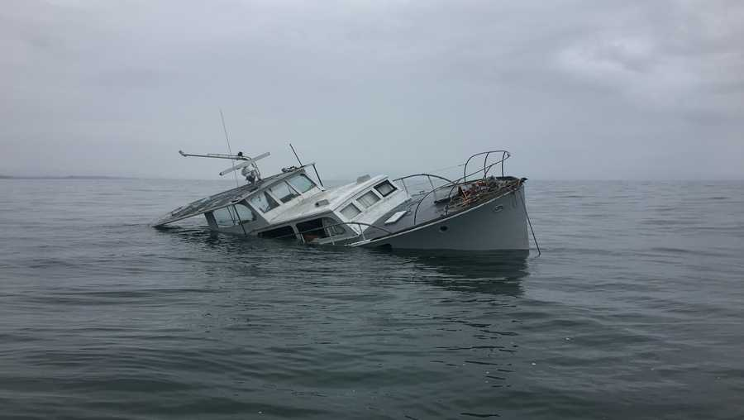
Editing Philosophy
Think like a reviewer!
Does the proposal/statement flow in ONE direction?
ROAD BLOCKS? SPEED BUMPS? ANCHORS?
Questions reviewers should be able to answer:
1. What is the student’s question and does it reflect our mission?
2. How will they answer this question?
3. What is the expected outcome?
4. Why should we fund THIS student?

Slide 18
Writing: Editing – Top Tips
20% of time is spent HERE!!!!
Subject -> Verb -> Object
Cut the Clutter- “as it is well known,” “it can be regarded that,” “it should be emphasized that,”
AGREEMENT within sentence, paragraph and document (tense and singular or plural)
Underline all your verbs:
Final check for form (numbers, format, font)
Reduce/eliminate: is, are, was, were, been, could be, shall be, should be, will be, has been, etc. These turn verbs into nouns. Nouns SLOW statements, verbs move them.
Eliminate negatives – restate it positively.
Can your proof reader identify:
the need for project
basic plan
expected result and impact
Eliminate “Alphabet Soup” Use acronyms that are commonly known. It is OK to repeat the whole word/phrase
Cut adverbs: “mostly” “usually”

Slide 19

Where can I search for opportunities?
Start here:
info.rpi.edu/external-graduate-fellowships
  Other institutions’ databases (links on OGE website):
  UCLA
  Worcester Poly
  Rutgers
  Georgia Tech
  New Mexico Tech
  MIT
  International Students: scholars4dev.com
Notes:
Just like different internet search engines produce different results, each funding database is going to find different opportunities, and in a different order.
There is no quick fix for this—like a job search, you have to put in the time on more than one site to find the best matches.

Slide 20

NSF GRFP
National Science Foundation Graduate Research Fellowship Program (NSF GRFP)
  Disciplines: Science and engineering fields supported by NSF (see website)
  Award: 3 years of support during a 5-year fellowship period, with a $34,000 annual stipend, opportunities for internships (GRIP), research abroad (GROW), and supercomputer access (XSEDE)
  Citizenship: US Citizen, US National, or Permanent Resident
  Academic Profile: Graduating senior entering a graduate program or current graduate student with less than 12 months of completed graduate study. Current graduate students are limited to 1 application, submitted in either the first or second year
  Due October to November. (Deadline depends on discipline; see website.)
Only major graduate fellowship program that provides feedback.
Contact OGE for workshop/information on THIS fellowship: madige@rpi.edu

Slide 21

US Government: Dept. of Defense
SMART Scholarship
  Disciplines: 21 STEM disciplines
  Award: Full tuition and stipend ($25,000 - $38,000 depending on degree); up to $1,200 for health insurance annually, Misc. Supplies Allowance of $1,000 each academic year, plus a paid summer research internships at DoD labs, plus employment placement after graduation (one year of employment required for every year of funding)
  Citizenship: USA, Australia, Canada, New Zealand, or United Kingdom
  Academic Profile: Undergraduate or graduate student able to participate in summer internships at Department of Defense (DoD) laboratories and willing to accept post-graduate employment with the DoD as a civilian research scientist
  Application is open in August and due early December

Slide 22

Lawrence Livermore National Laboratory
Lawrence Fellowship or Graduate Scholar Program
Disciplines: All technical disciplines that can strengthen U.S. security, including computation, engineering, and physicial and life sciences
Award: 3 Year fellowship > $100,000 + stipend
Citizenship: US Citizen, Permanent Residents, International Students
Academic Profile: Graduate Student in either Master’s, PhD, or both
  Due October

Slide 23

International Business Machines Corporation
IBM PhD Fellowship Program
Disciplines: Engineering, physical sciences, management, business, chemistry, computer science electrical engineering, physics, autonomic computing, nanotechnology, grid computing e-business on demand.
Award: $35,000 + benefits and mentor in IBM facility, renewable
Citizenship: US Citizen, International Students
Academic Profile: Graduate Student working on Dissertation; Faculty must submit proposal on behalf of student
  Due October

Slide 24



Foundations
  Disciplines: Applied physical, biological, and engineering sciences
  Award: Up to 5 years, full tuition and a $34,000 yearly stipend (over 9 months), $5,000 annual stipend for Fellows with dependent children
  Citizenship: US Citizen or Permanent Resident
  Academic Profile: Graduating senior entering a PhD program or in the first year of PhD program
  Application is open in August and due late October
Hertz Fellowship
Disciplines: Most (see website)
Award: 3 years of support in a 5-year fellowship period, with a $24,000 annual stipend and expenses paid to at least one Conference of Ford Fellows
Citizenship: US Citizen, Permanent Resident, DACA status
Academic Profile: Graduating senior or current research-based PhD or ScD student with ≥ three years of study remaining to degree
Application is open now and due mid December
Ford Foundation
Predoctoral Fellowship
Disciplines: All
Award: 1 to 2 year fellowship, including a total stipend up to $50,000 and tuition up to $20,000/year
Citizenship: Born in the US to parents born abroad as non-US citizens; Naturalized Citizen; Green Card holder; adopted from another country; DACA status (see website for more details)
Academic Profile: Graduating senior entering a graduate program or first- or second-year graduate student aged ≤ 30
Application is open in May and due early November
Paul & Daisy Soros Fellowship for New Americans

Slide 25



Fellowships for Women
American Association for University Women (AAUW) www.aauw.org *two separate awards
  Disciplines: All
  Award: $18,000 or $20,000
  Citizenship: US Citizen or International
  Academic Profile: Master or PhD student
  Application due November
Schlumberger Foundation – Faculty for the Future (FFTF) Predoctoral and Postdoctoral Fellowship for Women www.facultyforthefuture.net
  Disciplines: STEM
  Award: $50,000
  Citizenship: Developing Nation ONLY
  Academic Profile: PhD Students
  Application is due November
Amelia Earhart Fellowship www.zonta.org/global-impact/education/amelia-earhart-fellowship
  Disciplines: Aerospace
  Award: $10,000
  Academic Profile: Phd Student
  Application is due November

Slide 26


Fellowships for underrepresented minority students
National Physical Science Consortium
  Disciplines: STEM, Astonomy, Chemistry, Computer, Science, Geology, Materials, Mathematic, Physics
  Award: Up to 6 years, $20,000 yearly stipend (over 9 months), $6,000 for fees
  Citizenship: US Citizen or Permanent Resident
  Academic Profile: Graduate student that can work 1-2 summer internships at paid internships
  Application is open in August and due November
GEM Fellowship
  Disciplines: STEM
  Award: $24,000 yearly stipend for 3 years (tuition waved) + paid summer internships
  Citizenship: US Citizen or Permanent Resident
  Academic Profile: Graduating Senior or Graduate student that can work 2 paid summer internships
  Application is open in August and due November

Slide 27
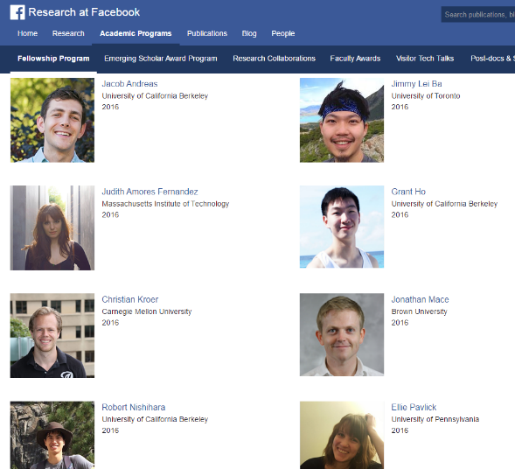
Facebook Fellowship Program
https://research.facebook.com/programs/fellowship
  Disciplines: Applied statistics, AR/VR Photonics and Optics, Computational Social Science, Computer Graphics, Computer Vision, Compute Storage and Efficiency, Distributed Systems, Economics and Computation, Machine Learning, Natural Language Processing, Networking and Connectivity, Programming Languages, Security/Privacy, Spoken Language Processing and Audio Classification, UX/Instragram Well-being, Hardware and Software Infrastructure for Machine Learning.
  Award: Full Tuition & $37,000 grant
  Citizenship: US Citizen, Permanent Resident, International students, underrepresented and minority students
  Academic Profile: PhD Students, underrepresented and minority
  Deadline: October 4th
*Read online about the research of the current fellows.

Slide 28

What would you do if you could do anything anywhere?
https://us.fulbrightonline.org
  Disciplines: ALL
  Award: 9 Month grant to study, do research, or teach English abroad
  Citizenship: U.S. Citizen
  Academic Profile: Graduate Student
  DUE IN-HOUSE September 12 for required interview with constructive feedback.
  DUE to Fulbright October 8th.

Slide 29

Contact information
Betty Madigan madige@rpi.edu | info.rpi.edu/external-graduate-fellowships
Office of Graduate Education, 1516 Peoples Avenue
Thanks for attending &
good luck with your search!

